Slide 1
Potential Practice Exercises for Module 2

Slide 2
Module 2 · Video 1 · Demand and Revenue
The Netflix 2014 Price Increase
In 2014, Netflix raised its monthly price by $1, from $7.99 to $8.99
Then: 50 million subscribers, own-price elasticity of demand ≈ −2
Implications of the price increase for:
  Number of subscriptions (quantitative)?
  Revenue (qualitative)?
  Profits (speculative)?
Group Discussion
Management 405 · Module 2 · Demand Analysis
2

Slide 3

Module 2 · Video 1 · Demand and Revenue
Solution: Netflix
Subscriptions decline — by how much? Use Method 1 with E_{D} = −2 :
$$E_{D} = \frac{\%ΔQ}{\%ΔP} = \frac{\%ΔQ}{12.5\%} = −2$$
where %ΔP = (8.99 − 7.99) / 7.99 = +12.5%, so %ΔQ = −25%
→ a 25% decline in subscriptions
Revenue: demand is elastic, so quantity outweighs price → revenue falls
Profits: fewer subscribers, near-zero cost savings → profits likely fell too
Management 405 · Module 2 · Demand Analysis
3

Slide 4
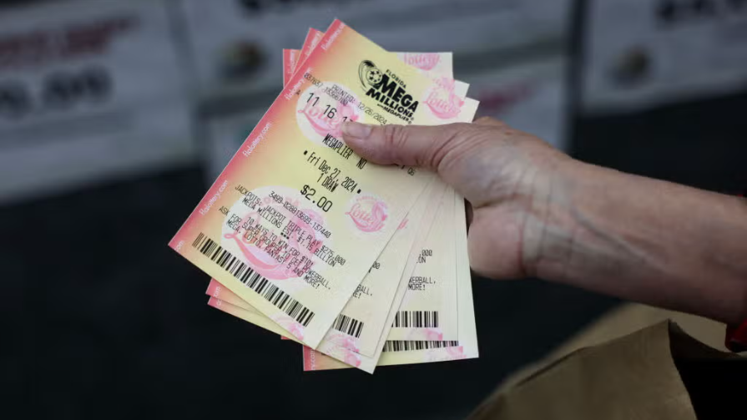
Demand Analysis · Elasticity and Revenue
Lottery Sales, Revisited
April 2025: Mega Millions raises its ticket price from $2 to $5
As a result, in Massachusetts, weekly ticket sales fell from about 142,000 to about 100,000
We computed E_{D} = −0.2
“When ticket prices went up from $2 to $5 last April, Massachusetts State Lottery saw fewer people buying tickets but much higher profits. Sales dropped by 30% while revenue climbed…” (Source)
Is the article right that revenue rose when the price went from $2 to $5?
Group Discussion
Management 405 · Demand Analysis
4

Slide 5
Demand Analysis · Elasticity and Revenue
Poll: Lottery Revenue
[ PollEverywhere slide – insert your poll here ]
Management 405 · Demand Analysis
5

Slide 6
Demand Analysis · Elasticity and Revenue
Solution: Lottery Revenue
Demand is inelastic: |E_{D}| = 0.2 < 1 → a higher price raises revenue
Check with the article's ticket counts:
  Before: R₀ ≈ 142,000 × $2 = $284,000
  After: R₁ ≈ 100,000 × $5 = $500,000
Yes – the article is right: revenue rose by about 76%
Management 405 · Demand Analysis
6
Notes:
With an elasticity of about −0.2, demand is well inside the inelastic range, so the 150% price increase outweighs the roughly 30% drop in tickets and revenue rises. From the rounded ticket counts: 142,000 tickets at $2 is $284,000; 100,000 tickets at $5 is $500,000 - up about 76%. Multiplicative check: 2.50 × 0.704 ≈ 1.76.
Caution (kept off the slide): the article's own dollar figures ($491,323 → $841,185, “+71%”) do not equal tickets × price (they imply $3.46 and $8.39 per ticket), so they must cover more than the base ticket sales counted here; the revenue check above uses the reported ticket counts (142,170 and 100,297, rounded), and the qualitative conclusion is unchanged. Source: WROR / BostonNewsroom, April 10, 2025, citing the Massachusetts Lottery (WBZ-TV).

Slide 7


Module 2 · Video 2 · Marginal Revenue
Inside Out 2's Marginal Revenue
Demand for streaming Inside Out 2 on Disney+ (Q: viewers, in millions):
$$Q = 20 − \frac{1}{2}P$$
What is the revenue-maximizing price?
Why might Disney care about revenue maximization?
Poll Break
Management 405 · Module 2 · Demand Analysis
5

Slide 8
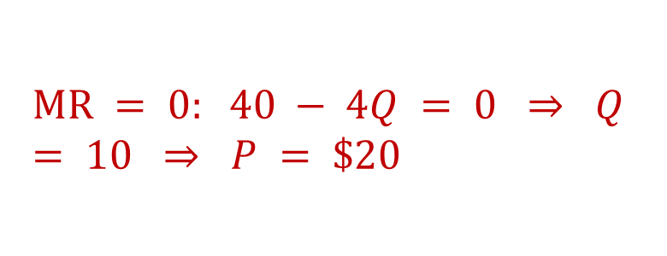
Module 2 · Video 2 · Marginal Revenue
Solution: Inside Out 2's Revenue-Maximizing Price
Revenue is maximized where MR = 0 . Compute MR using the 3-step method:
1. Inverse demand: P = 40 − 2Q
2. Total revenue: TR = 40Q − 2Q²
3. Derivative: MR = 40 − 4Q
$$MR = 0: 40 − 4Q = 0 ⇒ Q = 10 ⇒ P = \$20$$
Why revenue maximization? The marginal cost of one more stream is close to zero – so maximizing revenue is (almost) maximizing profit
Management 405 · Module 2 · Demand Analysis
6

